Slide 1

Deep Reinforcement learning
Sandy Adel

Slide 2
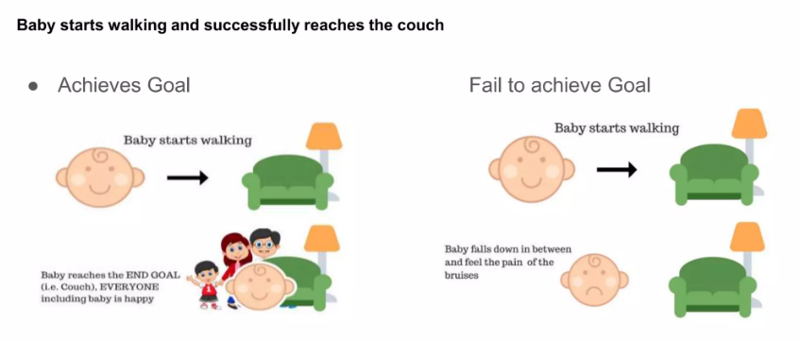

Slide 3

introduction
Deep reinforcement learning (deep RL) is a subfield of machine learning that combines reinforcement learning (RL) and deep learning
RL considers the problem of a computational agent learning to make decisions by trial and error
Deep RL algorithms are able to take in very large inputs
Deep RL incorporates deep learning into the solution, allowing agents to make decisions from unstructured input data without manual engineering

Slide 4
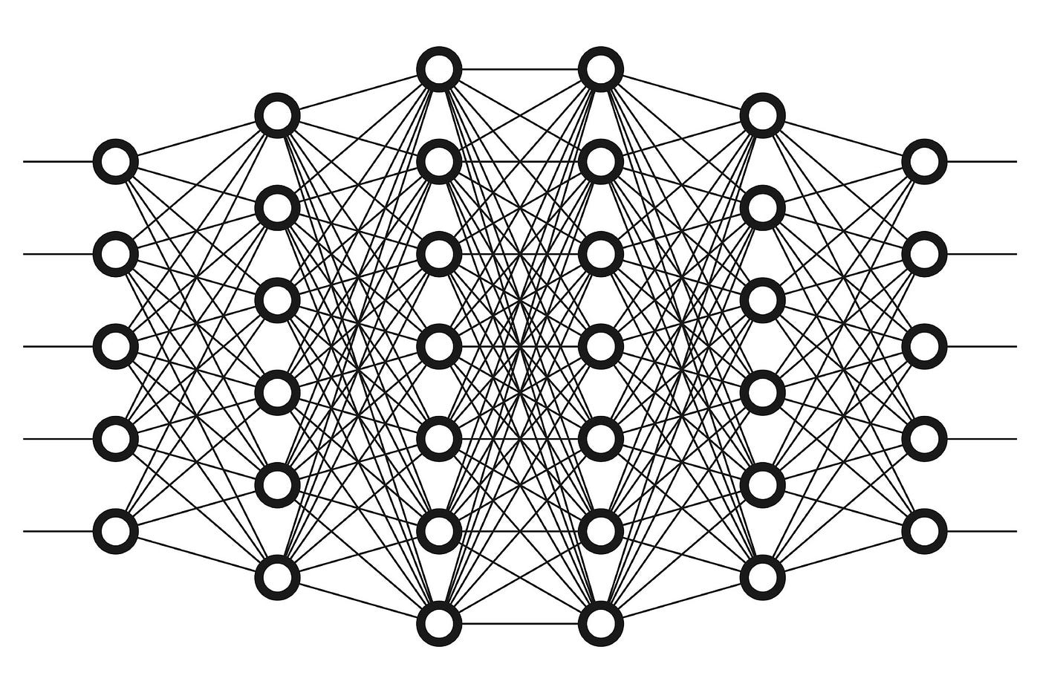
Deep learning
Deep learning is a form of machine learning that utilizes a neural network to transform a set of inputs into a set of outputs via an artificial neural network. Deep learning methods, often using supervised learning with labeled datasets, have been shown to solve tasks that involve handling complex, high-dimensional raw input data such as images, with less manual feature engineering

Slide 5
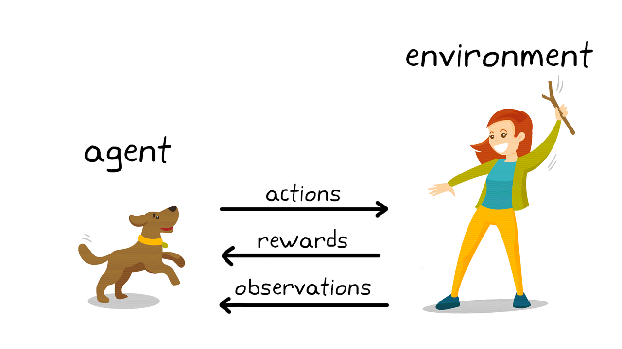

Reinforcement learning
Reinforcement learning is a process in which an agent learns to make decisions through trial and error. This problem is often modeled mathematically as a Markov decision process (MDP), where an agent at every timestep is in a state s , takes action a , receives a scalar reward and transitions to the next state s` according to environment dynamics p(s`|s,a) . The agent attempts to learn a policy $π(a|s)$ , in order to maximize its returns (expected sum of rewards)

Slide 6
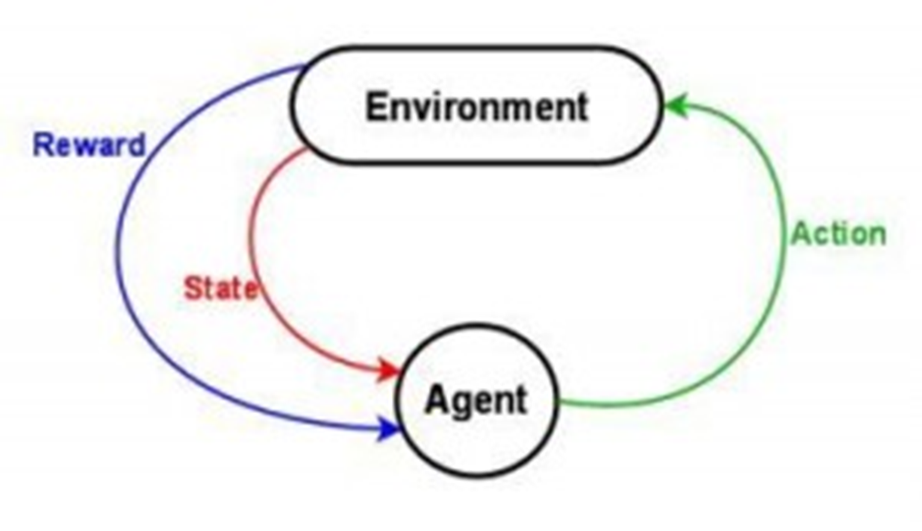
Markov decision process
A Markov decision process is a 4-tuple (S,A,P,R) , where:
S is a set of states called the state space
A is a set of actions called the action space
p(s,a,s`) is the probability that action a happen to transaction from state s to s`
R(s,a,s`) is the immediate reward (or expected immediate reward) received after transitioning from state s to state s` , due to action a

Slide 7

notes
Rewards can be negative , then we think of them as punishment
In many cases rewards depend only on s` ( reaching a certain state yields a reward )
Stochastic transactions contain deterministic transaction as a special case
Some state can be terminal
Goals in planning can be encoded as a terminal state as a positive reward

Slide 8
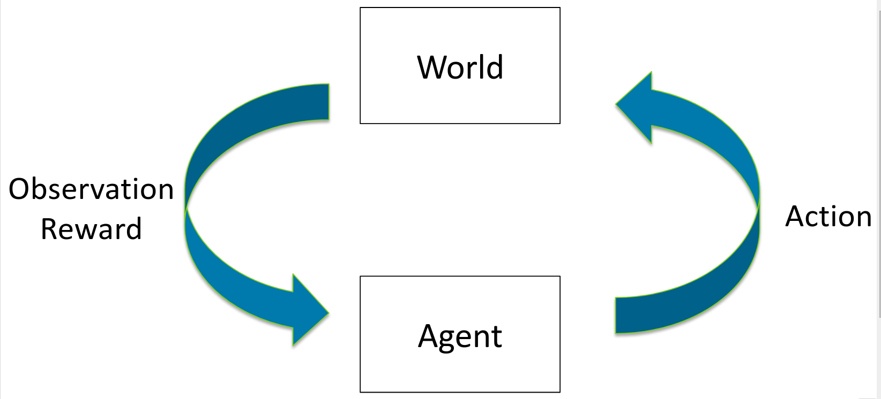
Reinforcement learning notes
In RL , we aim to learn a policy that tells the agent how to act , starting in any state
In RL , environment dynamics are unknown
In a planning , we aim to reach a goal state , starting from initial state
In a MDP , there is no such a goal and the initial state may be variable
Instead , we aim to maximize rewards
Optimal policy : is a policy that maximizes the expected accumulated discounted rewards

Slide 9
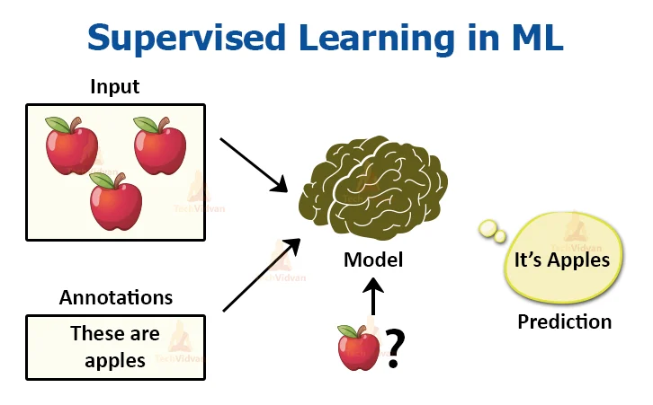
Relation to supervised learning
Learning signal : label (SL) VS scalar reward (RL)
SL : best action (label) is given
RL : trial and error , observe reward
SL : static world
RL : controller in the loop

